Slide 1
ANIMAL BEHAVIOUR
Department of zoology
DARAKSHA ZAREEN

Slide 2
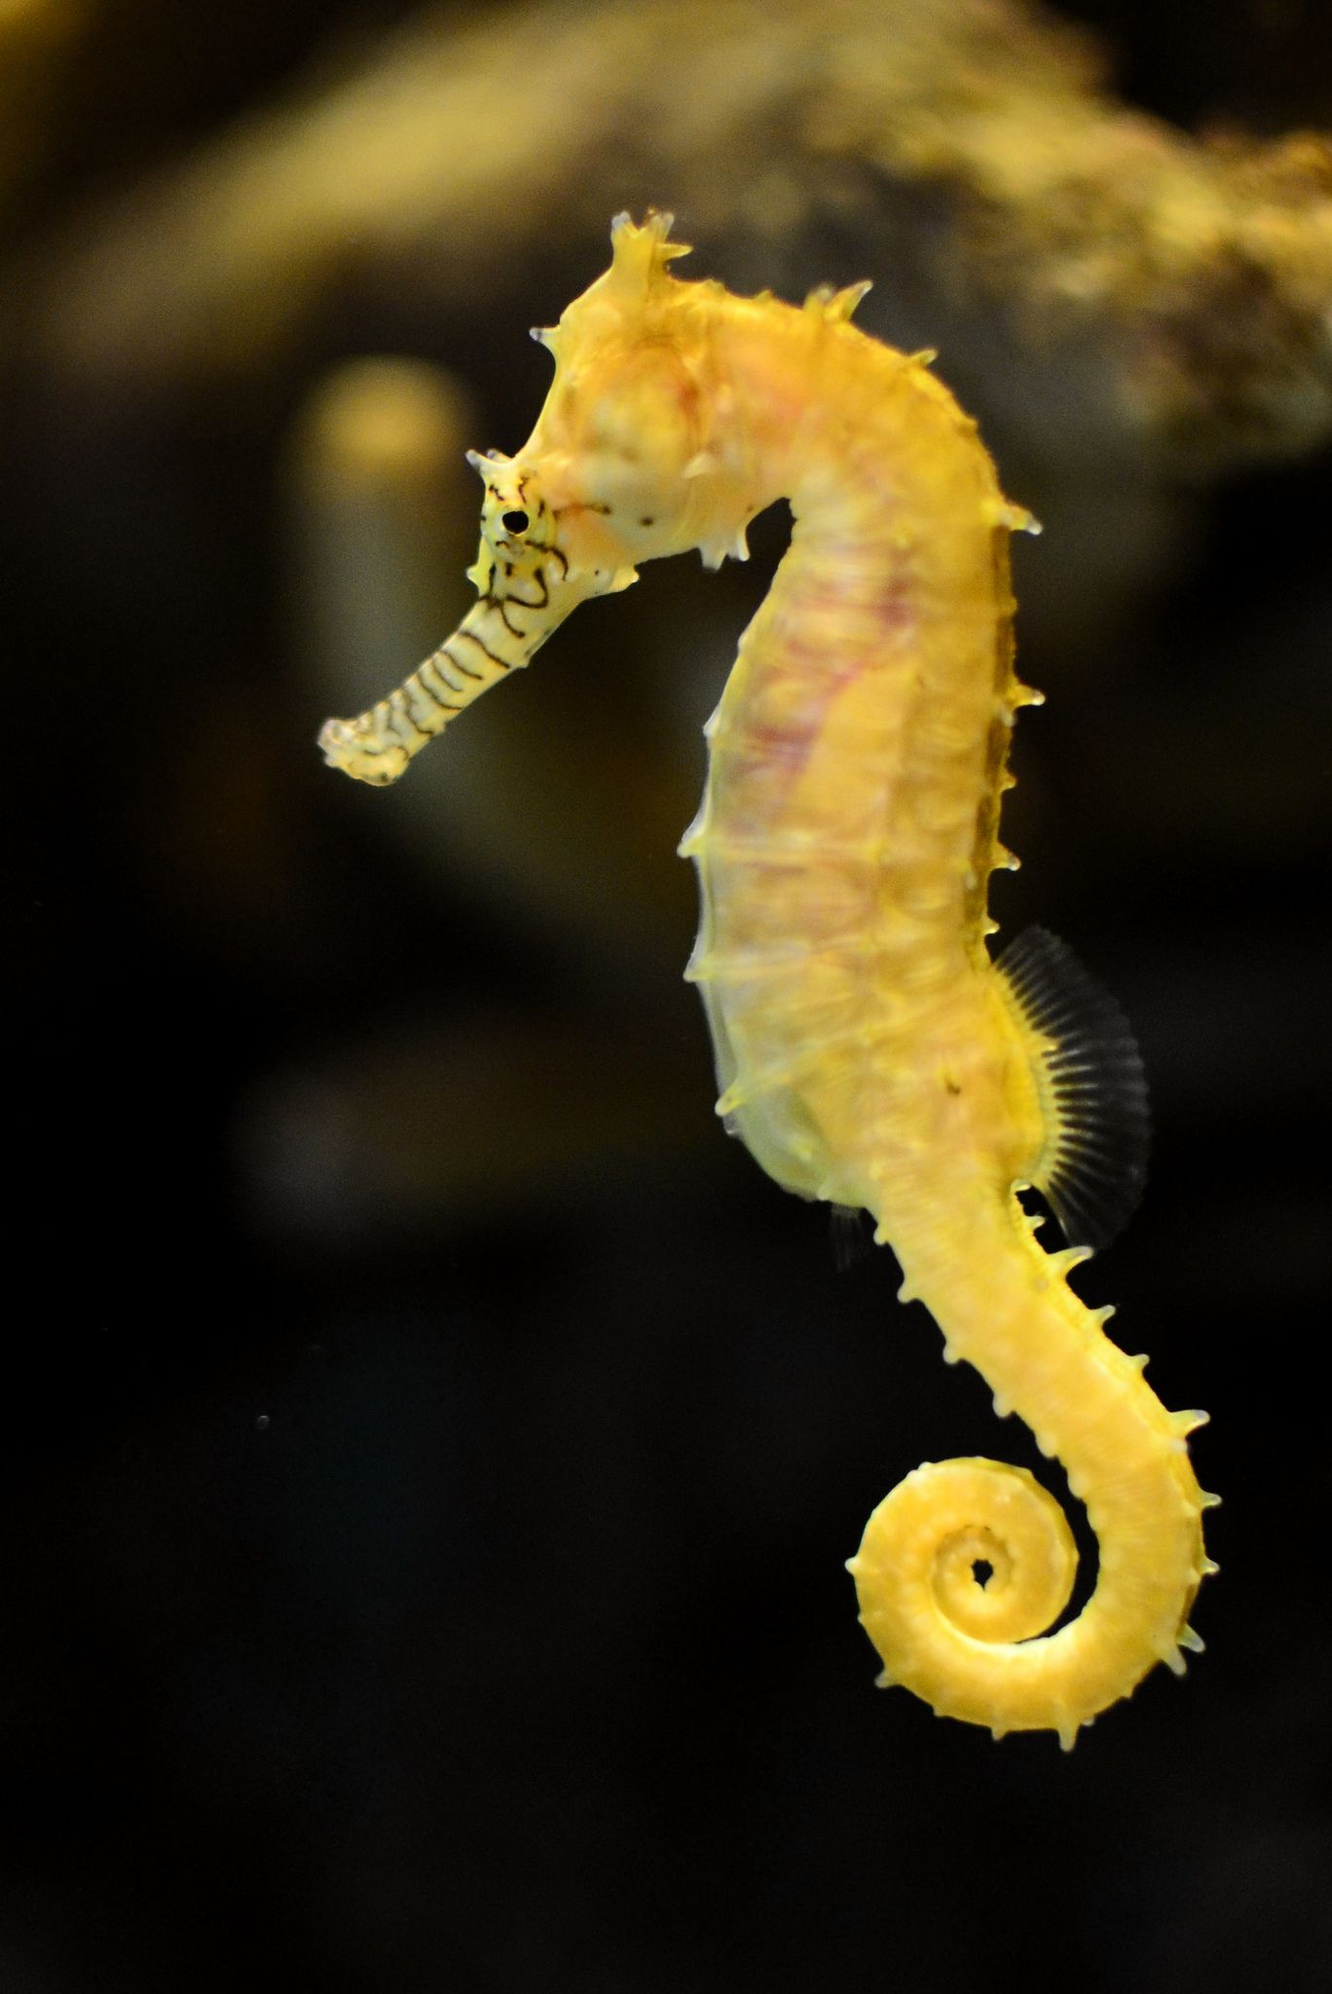
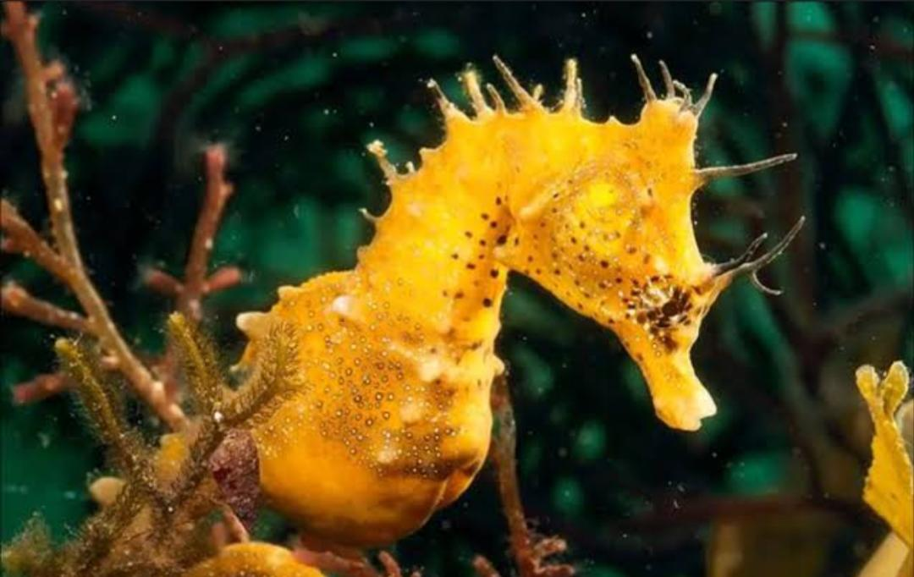
Chordate Name: SEAHORSE
Common Name : Yellow Seahorse
Scientific Name : Hippocampus kuda
Hippocampus kuda is a species of seahorse, also known as the common seahorse, estuary seahorse, yellow seahorse or spotted seahorse.

Slide 3
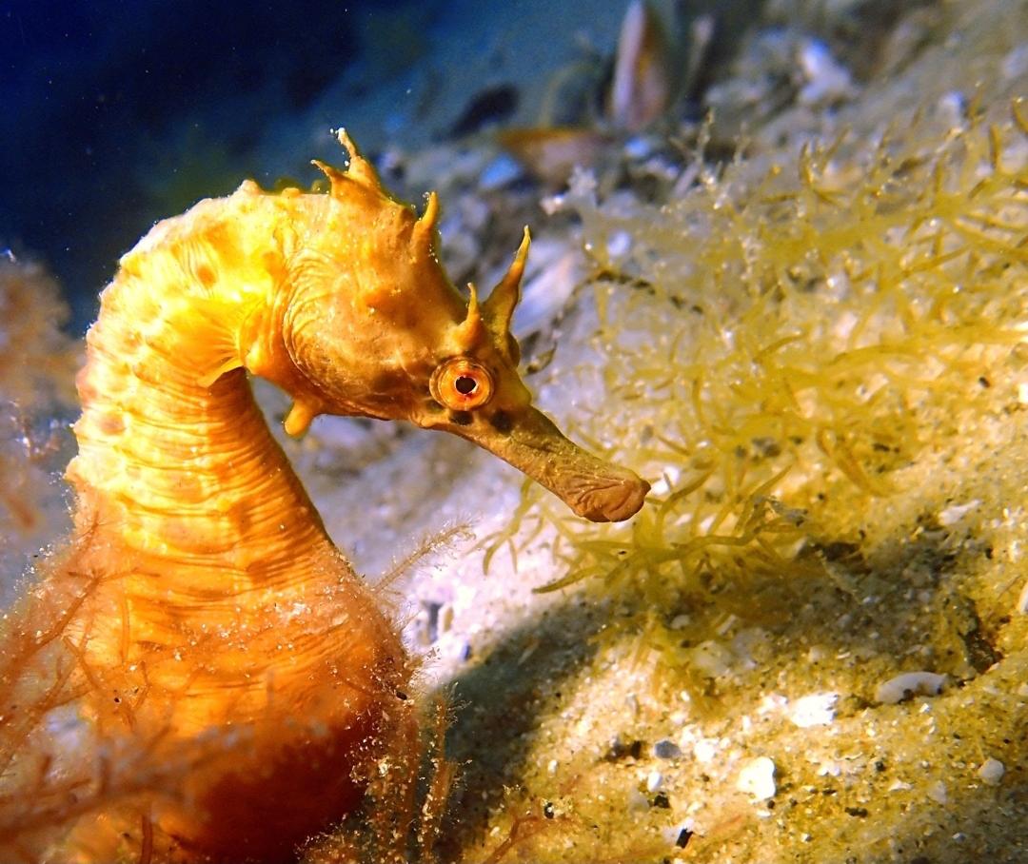
Seahorse
Systematic position of seahorse:
According to Young, 1981.
Kingdom : Animalia Phylum : Chordata Class : Actinopterygi Order : Syngnathiformes Family : Syngnathidae Subfamily : Hippocampinae Genus : Hippocampus Species : Hippocampus kuda
The name hippocampus is derived from the Greek hippokampus (hippos, meaning “horse,” and kampos, meaning “sea monster”)

Slide 4
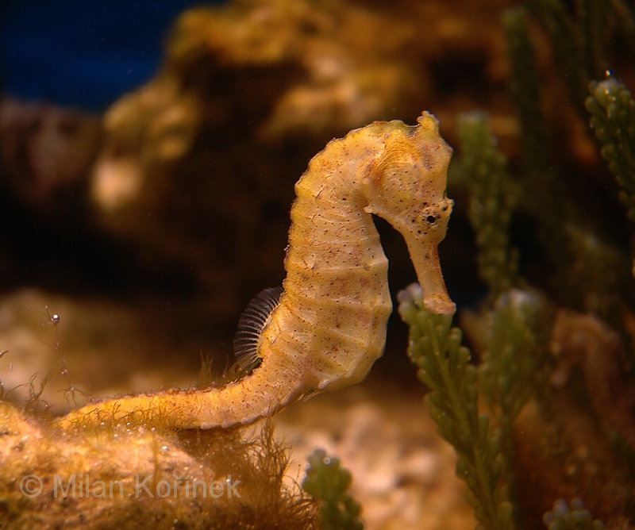
General Behaviour:
Seahorse is fully monogamous. This species performs a unique courtship ritual before copulation. The male dances around the female In alternating colour patterns and clicks with his coronet.
It is small and can reach a length of 17 to 30 cm.
They have dorsal fan which helps them to move vertically.
They have a short, thick and elongated snout.
They have a well defined flexible neck.

Slide 5
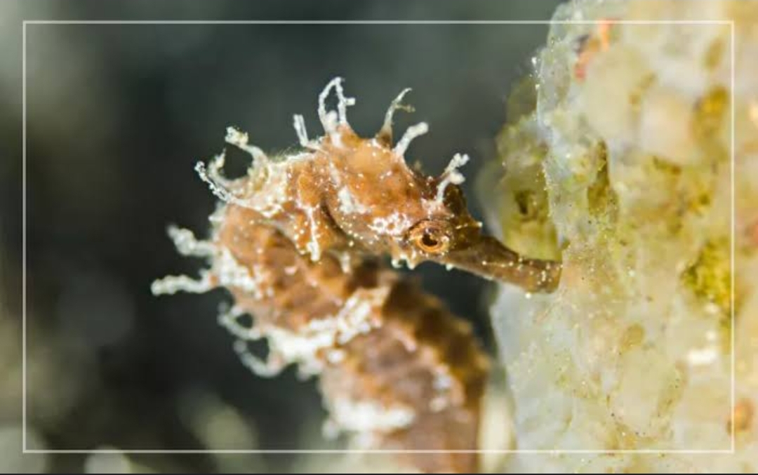
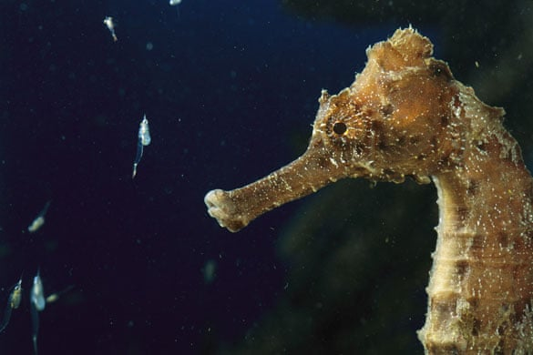
Feeding Behaviour:
The feeding behaviour of the wild and cultured Hippo campus Kuda includes 6 steps:
Searching, locking, alerting, catching,swallowing and
withdrawing.
Seahorse are omnivores, feeding on minuscule living pray, such as larvel fishes and zooplankton, via suction feeding.
Seahorses eat tiny organisms such as small shrims as well as small very small fish and plankton.
Sometimes they eat small fish larvae or anything small enough for them to swallow.
Seahorses eat sucking through their tube like snout.

Slide 6
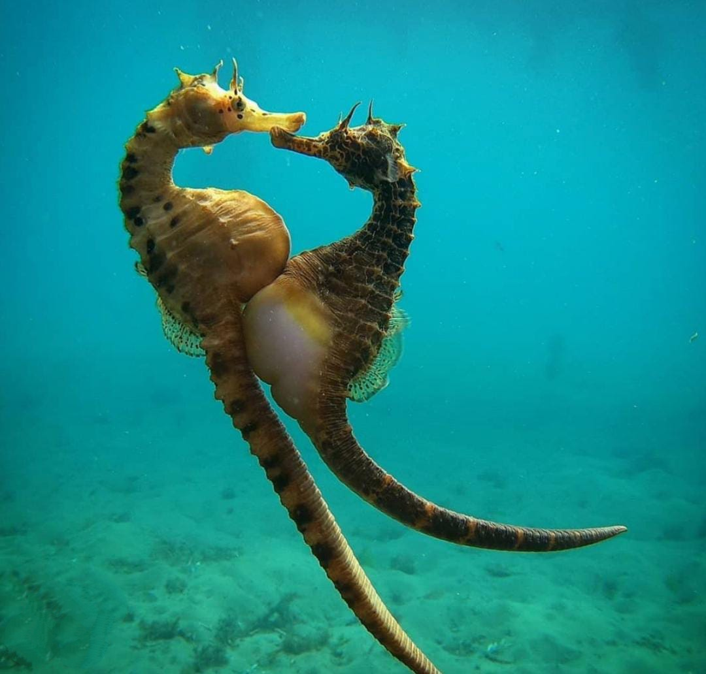
Breeding behaviour:
Reproduction Seahorses exhibit paternal care in its most extreme form. Their possesses a special enclosed brood pouch into which the female deposits her eggs and male than fertilizers them. Incubation can take between 10 days and 6 weeks depending on species and they can give birth to between 50 and 1500 babies each pregnancy.
Sea horse Reproduction Male sea horses are responsible about pregnancy and giving birth. Pregnancy lasts between two and four weeks the length decreasing with increasing temperature.

Slide 7
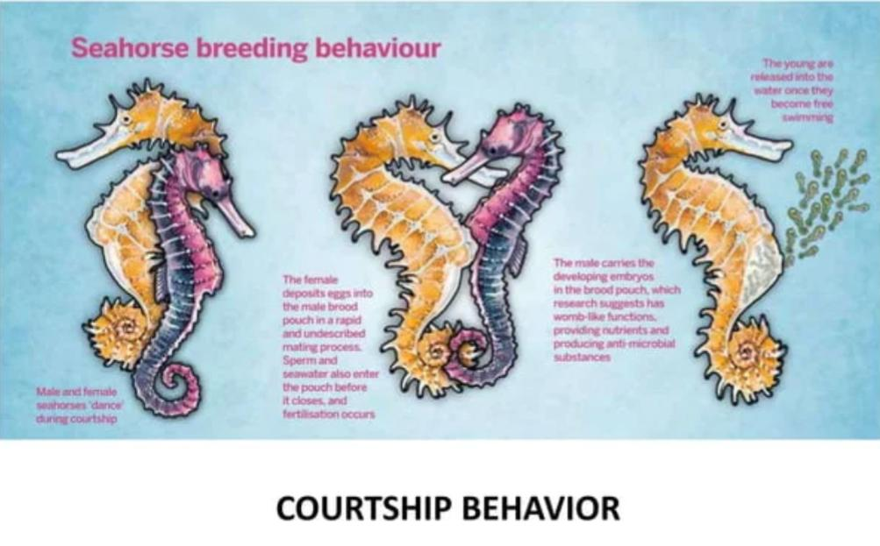
Breeding behaviour:
Courtship
The reproductive process begins when male and female seahorse do daily pre_dawn dances.
The coating ritual involves dancing, changing colour and entwining tails.
Sometimes, more than one male seahorse will compete to win the affections of a female.
Male can inflate their pouch by pumping water through it to display its emptiness.
The purpose of courtship behaviour is to entice the female to deposit her eggs in it.

